Slide 1
Object Oriented Software Engineering (OOSE)

Slide 2
Software Engineering transforms requirements into code
Object–oriented software engineering is the process of systematically building software systems using objects, types and classes.
A system’s structure and design are defined by its types and classes and the relationships between them.
Object-oriented software engineering is an object-oriented, graphical modeling notation that provides a clear and precise modeling language that allows us to describe an architecture and components that will ensure the development of robust, reuse-supporting systems.
The task of the software engineering process is to turn an informal statement of a problem in the real world (the requirements) into a limited amount of code (the system).

Slide 3
Software Engineering is a team process
Software engineering is the process in which a team of people build software system using systematic engineering principles and techniques, such as model building, simulation, estimation and measurement.
The development of most software system involves the creation and evolution of several software artifacts or workproducts.
These workproducts are diagrams, source code files, test files, installation scripts, design documents and user documents.
Each of these workproducts describes a different aspect of system, of interest of different member of the software engineering team, customers, or users.

Slide 4
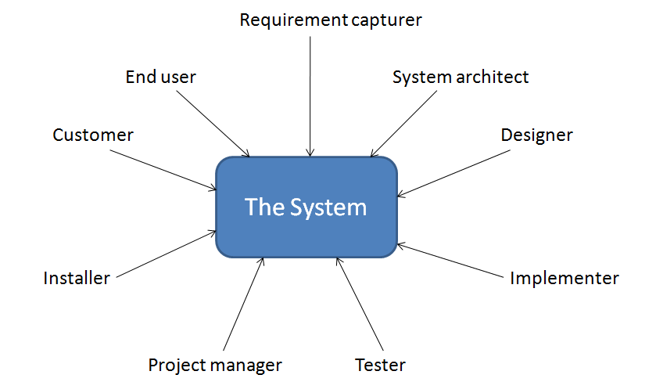
Software Engineering is a team process
Cont…

Slide 5
Software engineering is systematic model building
Software engineering is the process of building several related models. Each model defines a specific aspect of the system.
These models are described using several diagrams and documents that have a prescribed format.
Each model is examined or manipulated by different people (stakeholder) with different specific interests, roles or tasks.
Stakeholder
  Someone who is interested in using the system, understanding the system, placing requirements on the system, or developing some part of the system.
  Stakeholder may be a worker within the software development organization (engineer, manager), or someone outside the organization (customer, installer, end user).

Slide 6

Software engineering is systematic model building
Cont…
An application system is referred to as a set of models describing the software system.
Each application can be specified, ordered, and paid for by customers, developed by software engineers, and installed more or less independently of other application systems.
Software engineering has five main activities:

Slide 7
Software engineering is systematic model building
Cont…
Software engineering activities
1. Requirement Capture: Customers and end users work with requirements capturer to specify the different use scenarios of the system.
2. Robustness Analysis: Analyst then develop an analysis model that helps to build a structure that is reusable and robust when faced with changing requirements.
3. Design: The designer develop the design model which express how the system is to be implemented.
4. Implementation: The implementers implement this detailed design in some programming language, filling in the remaining details to produce the implementation model of the system.
5. Testing: The tasters develop a test model that describes how the resulting system should be inspected and tested, to verify that all requirements are fulfilled and that an appropriate level of quality is met.

Slide 8
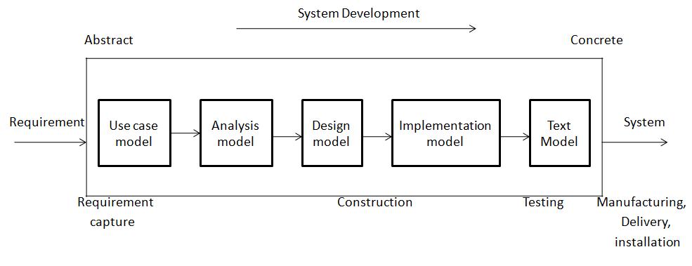
Software engineering is systematic model building
Cont…
Each stakeholder may needs to see a different aspect of system.
Thus, the software development team needs to build several different, but related models.
Software engineering is the process of building models for different stakeholders

Slide 9
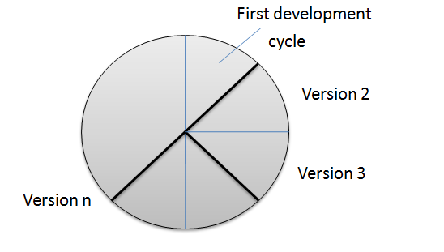
Software engineering is systematic model building
Cont…
The incremental, iterative software engineering life cycle
  System development is a cycle that starts with “Greenfield” engineering of the first version, and proceeds to deliver successive versions over time.
  Development of the first version from scratch is called Greenfield development.

Slide 10
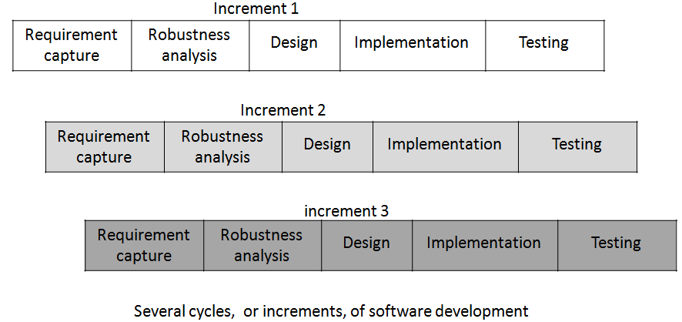
Software engineering is systematic model building
Cont…
  In first few increments, we plan the overall series of increments and develop the base architecture.

Slide 11
Object unify the modeling process
An object is a modeling and programming construct that effectively represents things in the real world as well as in the models of the system.
In the real world, objects have a state and they operate.
Object represents the abstraction in the real world.

Slide 12

Object unify the modeling process
Cont…
Objects contain both behavior and data:
  Object encapsulates data and behavior, hiding details from view outside the object.
  Object is an instance of a type.
  Object represented by a rectangular shape.
  MyCheck is instance of Account type.

Slide 13
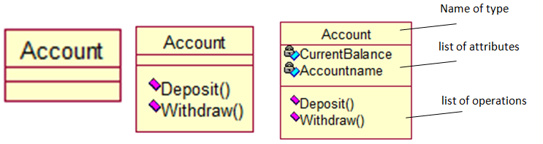
Object unify the modeling process
Cont…
Objects contain both behavior and data:
  A type is a description of a set of instance that share the same operation, attributes and relationships.
  A type is also shown by a bold rectangular shape with several variations.

Slide 14
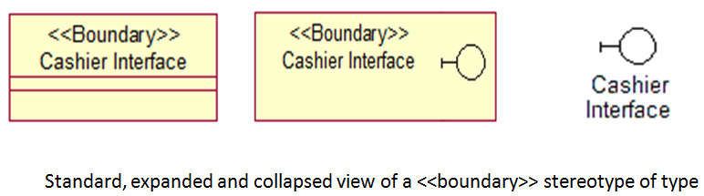
Object unify the modeling process
Cont…
Stereotypes define different kinds of types, classes and other elements
  UML provide the concept of stereotype to allow the definition of new kinds of types, classes and other UML constructs used in the various models.
  Stereotype is a tag or symbol, used to mark the type of an object or other construct so that it can be distinguished and treated differently from other types of constructs.
  There are following three formats for showing stereotypes:

Slide 15
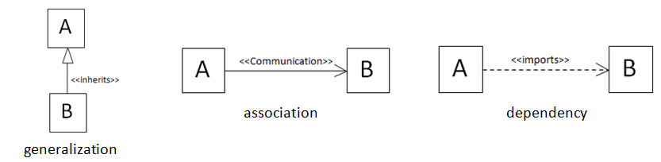
Object unify the modeling process
Cont…
Relationships connect objects:
  A relationship is a semantic connection among model elements (types, classes, use cases).
  Shown using solid or dashed line with one or several kinds of arrowheads, bi-direction or unidirection or Labeled or <<stereotype>> is attached to the line.
  Important relationships: generalizations, associations, dependencies.

Slide 16
Object unify the modeling process
Cont…
Packages and subsystems group classes, types and other elements-
  Package- is a general purpose mechanism for organizing elements into groups. Packages may be nested within other packages.
  System- A single high-level package, with every thing else in the system contained in it.
  Subsystem- is a kind of package, marked using the <<subsystem>> stereotype, used to divide the system into smaller parts.
    It may contain other subsystems.
    Lowest level of subsystem is called a service package.

Slide 17
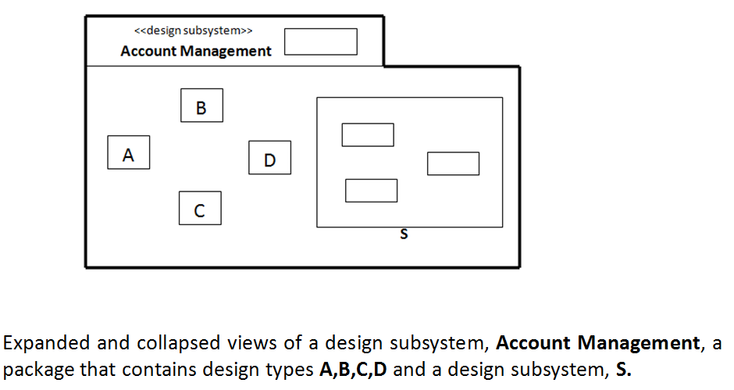
Object unify the modeling process
Cont…

Slide 18


The use case model captures system requirements
Use case is used for requirement analysis.
It consists of actor types and use case types.
Use case:
  Represent behavior of the system.
  Develop according actor’s needs.
  Drawn as ellipses.
Actor-
  Anything that interacts with the system (exchanges data and events).
  Represent particular type of user.
  A user can act as several different actors.

Slide 19
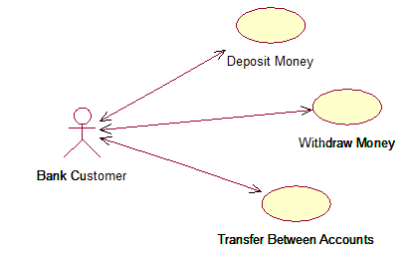
The use case model captures system requirements
Cont…
Use case model:
  Define what the system should do.
  Allow the software engineers and the customers to agree on this.
  Closest to the requirement.
  Drive the rest of the development work.
  Starting point for the object modeling activities.

Slide 20
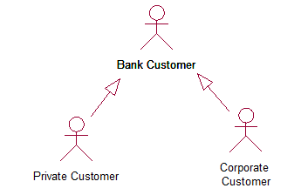
The use case model captures system requirements
Cont…
Actors model roles:
  An actor can be a human user, external hardware, or another system.
  Instances of several actors can interact with instances of a particular use case.
  Actor communicate wit the system by sending and receiving messages.
  A Private Customer and a Corporate Customer can be seen as variant of Bank Customer.

Slide 21
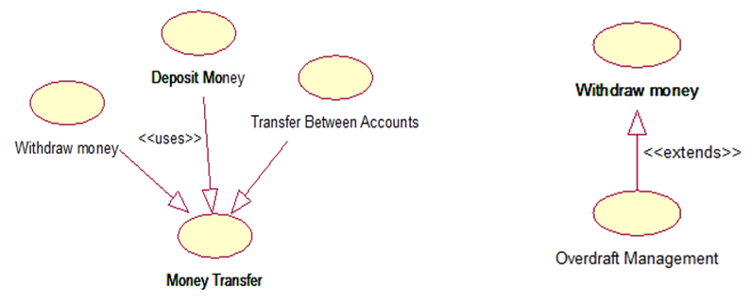
The use case model captures system requirements
Cont…
Use cases generalization:
  Two important use case generalization mechanisms-
    <<uses>> <<extends>>
    <<uses>> generalization from use case A to use case B indicates that A inherits B.
    <<extends>> from B to A indicates that an instance obeying that use case and instead begin obeying use case B.

Slide 22
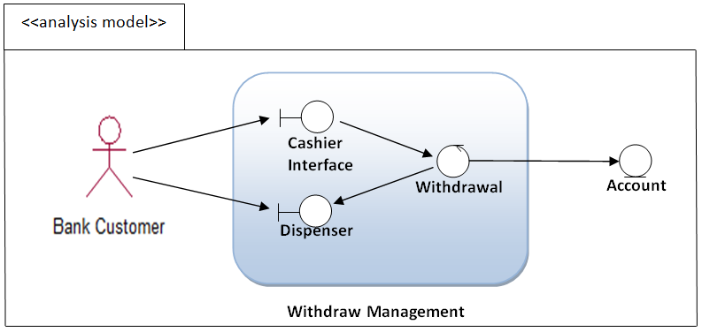
The analysis model shapes system architecture
Analysis model:
  Model of the system design at a high level, ignoring the specific low-level details of the target implementation environment.
  Consists of analysis types and subsystems with their relationships.

Slide 23
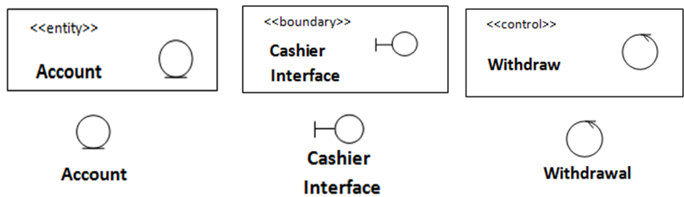
The analysis model shapes system architecture
Cont…
Analysis object:
  Represent a situation where objects are executed in an ideal system.
  OOSE provides three analysis stereotypes- <<boundary>>, <<control>>, and <<entity>>.
  The <<entity>> objects is in general a long-lived object in the system.
  The <<boundary>> objects handles communication between the system and its surroundings.
  The <<control>> objects performs use-case-specific behavior.

Slide 24
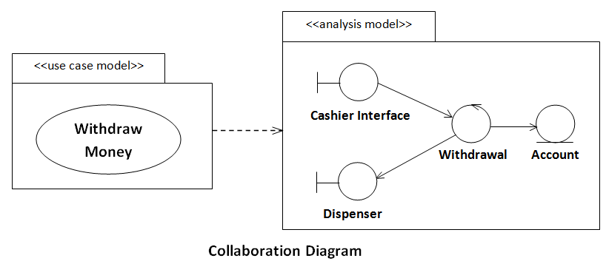
The analysis model shapes system architecture
Cont…
Collaboration Diagram:
  Represent how object perform the use case.
  Analysis objects interact in performing the use case instances.
  Each analysis object plays one or more roles in at least one use case.
  Collaboration diagram can be drawn for each individual use case or for each group of use case.

Slide 25
The analysis model shapes system architecture
Cont…
Sequence Diagram:
  Shows more detailed message flow and operation details.
  Commonly used with design model.
  Show the details of object interactions during a use case instance.
  In this diagram an object represent by a vertical column.

Slide 26
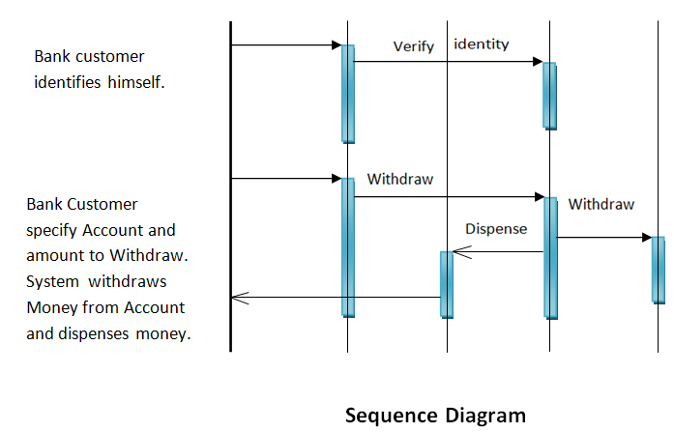
The analysis model shapes system architecture
Cont…
Bank customer
Cashier interface
Dispenser
Account
Withdrawal

Slide 27
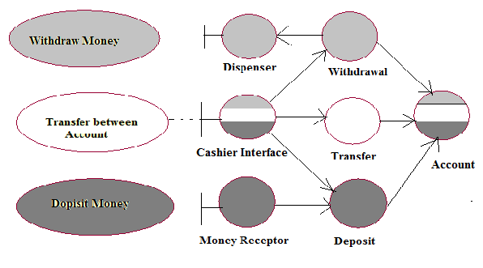
Analysis model with three susbsystems

Slide 28
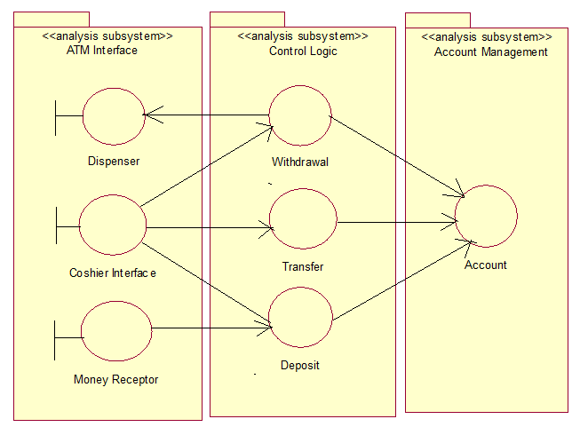
Analysis model with three susbsystems

Slide 29
The design model defines the implementation
Design Model:
  Serves as higher-level view of source code.
  Shows a blueprint of how the source code is organized.
  Consists of design classes and design subsystems.
  Like analysis model, the design model is organized into subsystem, in which lower-level subsystems and design classes are grouped.

Slide 30
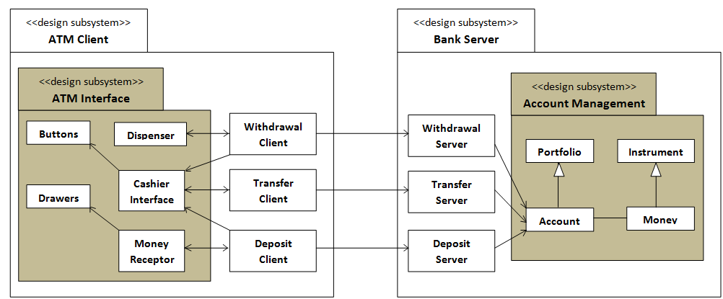
The design model defines the implementation
Cont…

Slide 31
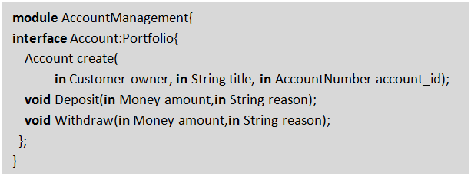
The implementation model is the code
Implementation model:
  Consists of the source code, classes, and also necessary documents and annotations to make the code readable.
  The most important principle is to define the interfaces explicitly, since this simplifies reuse and component-based development.
  Example:- Following is part of the definition of the operations for the Account class.

Slide 32
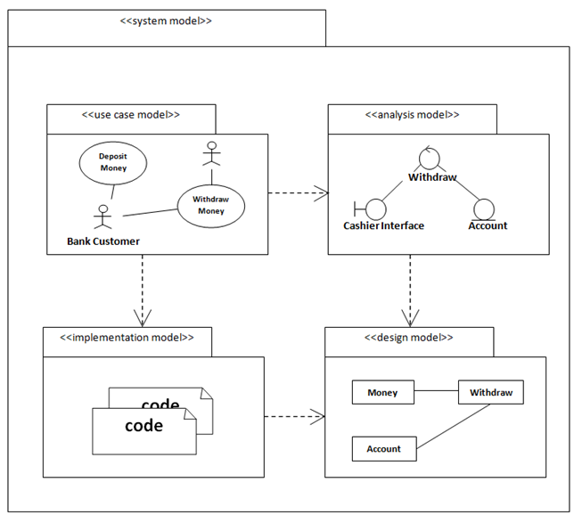
An OOSE system a set of models, packaged together, and connected with trace links

Slide 33
The test model validates the system
Test model is used to confirm the validity of the other models produced during software engineering.
Test cases
Test plan
Test case execution
Test result
Inspections and reviews

Slide 34
Exercise
Perform OOSE for online submission of semester fee through MP Online web portal.
Perform OOSE for Library Management System.

